Slide 1
Foot Traffic Analyzer
SEIS-744- Internet of Things
Taif Munsur

Slide 2
Project Background
Motion detector for retail stores or small business
Installed by the main entrance to detect motion
Measure foot traffic data and compare it to other business data to make smart decisions

Slide 3
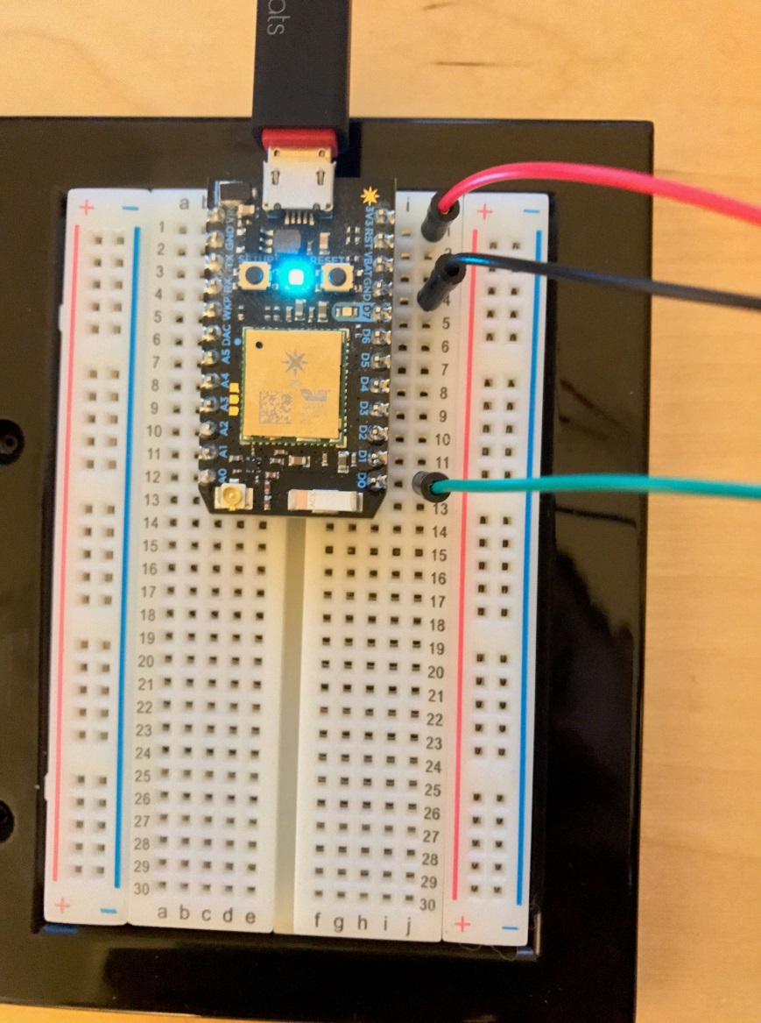
Design
Hardware: Arduino, PIR Motion Sensor, Particle
Software: Particle Build and Particle Console

Slide 4
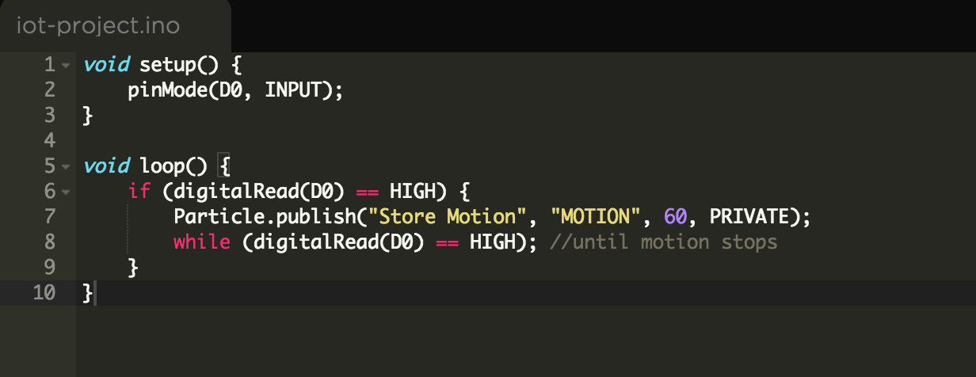
Code

Slide 5
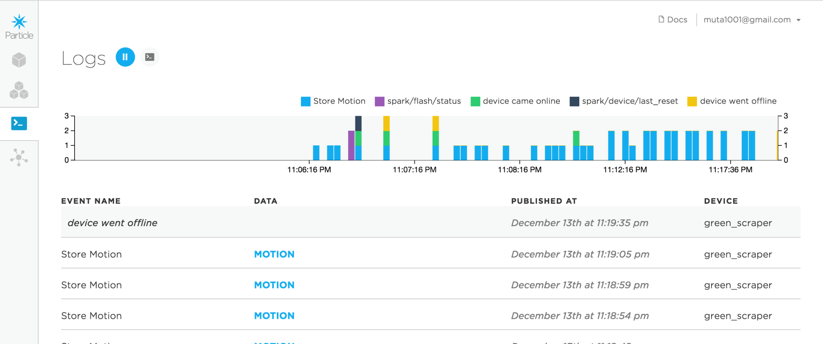
Demo

Slide 6
Product Use
Market: small business like retail stores
Scalability: can be mass produced
Calm technology: simplicity, cheap hardware, gets better with time

Slide 7
Product Use
Foot traffic analysis
Conversion rate analysis
Promotion impact on foot traffic or sales
Optimize staffing
Optimize adverting

Slide 8
Future Development
Data collection and analysis
UI design and reporting
Metrics Example: https://www.thinkwithgoogle.com/infographics/black-friday-store-traffic-data.html
Link sales, promotion, schedule and foot traffic
Customize advertising
Sensors for different departments within a store
Advanced prototype- different types of entrance
False positives data handling
Security feature

Slide 9
Lesson Learned
Better understanding of Internet of Things
Calm technology
Arduino, Particle
Entrepreneurship Factor
Crowd Funding

Slide 10
Questions?

